Slide 1
The Product Recommendation for H&M
Course: BIA 679
Instructor: Dr. Mohammad Nikouei

Slide 2


Slide 3
Project Introduction
Goal: Provide product recommendations based on customer purchase intentions for clothing or shopping sites
Describe: Predict consumer purchases with a dataset of consumer purchase records published on Kaggle by H&M. Models can provide companies with products that consumers are likely to buy. Therefore, online shopping platforms can provide recommendations to consumers based on the results of the model
Software: Spark
Python
PySpark

Slide 4
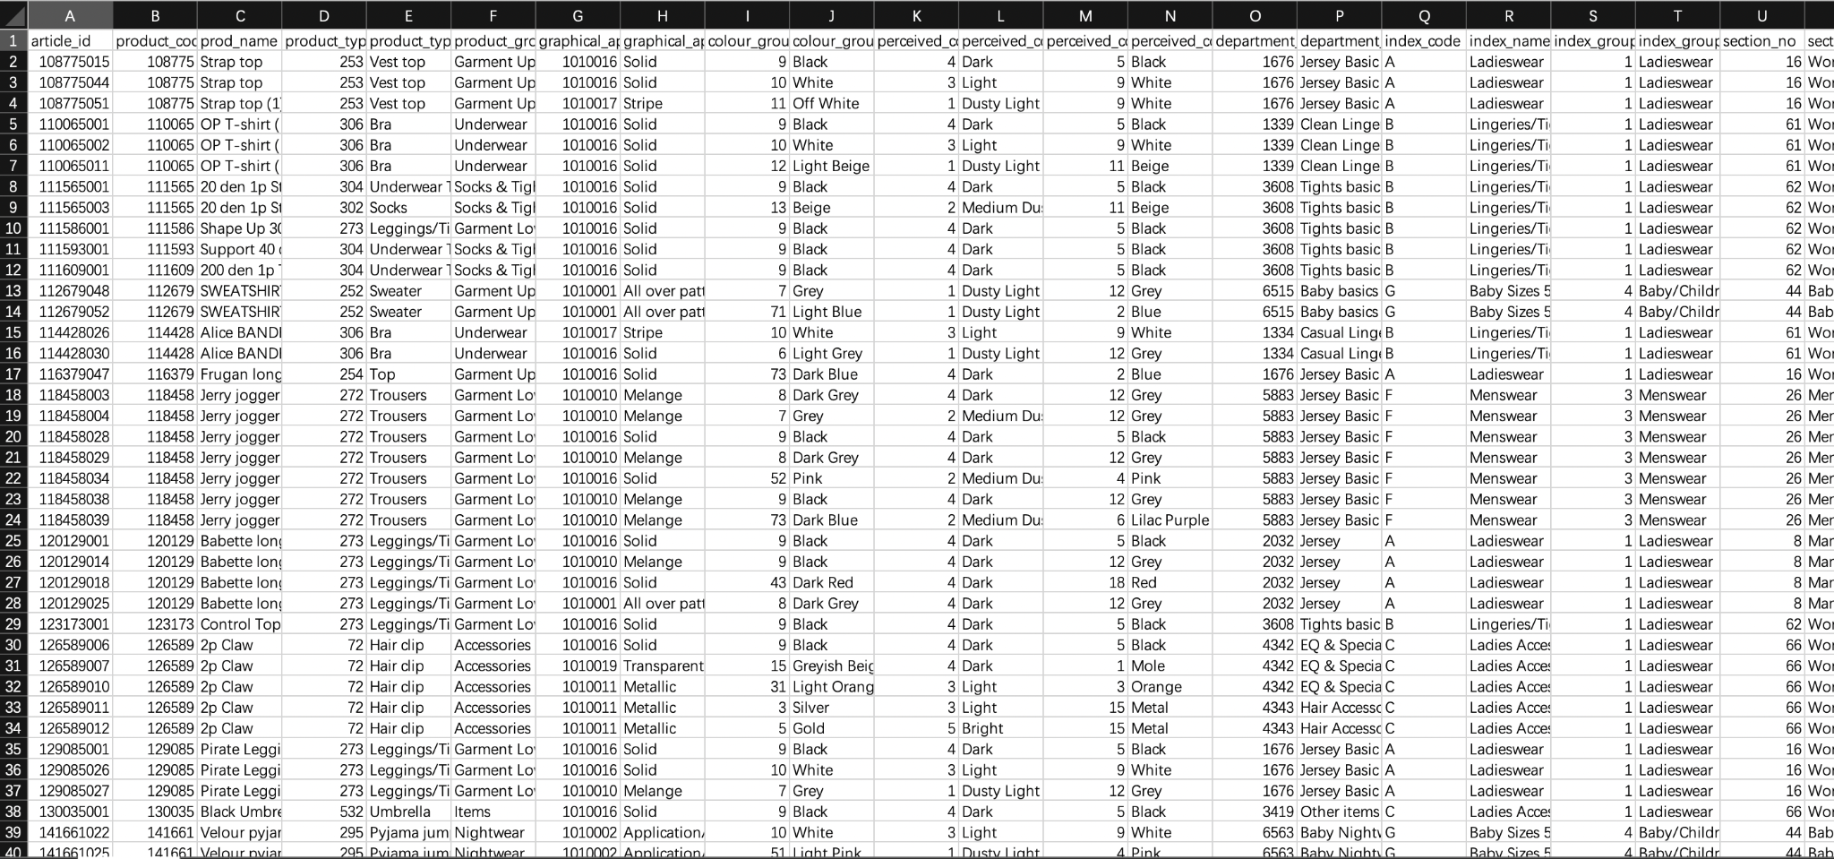
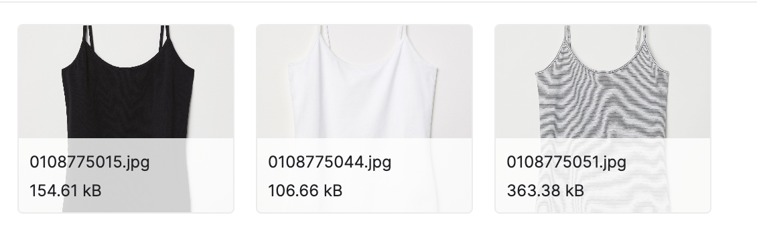
Project Introduction
Dataset: https://www.kaggle.com/competitions/h-and-m-personalized-fashion-recommendations/data

Slide 5
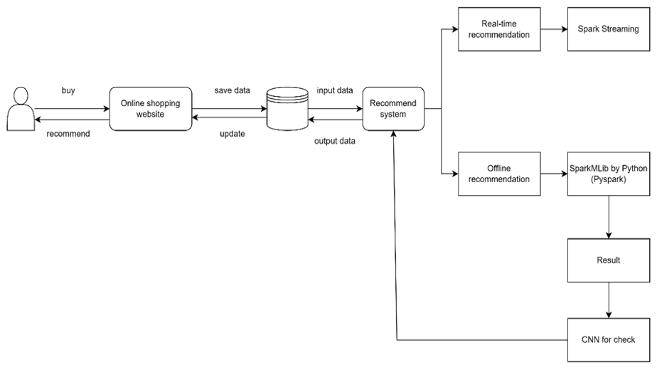
Model design

Slide 6
Collecting & Understanding Data
Data Intro | Amount | Size
Columns of Articles | 23 variables | 36.14MB
Columns of Customer | 7 variables | 207.14MB
Image | 105k | 28G

Slide 7
Columns | Feature
customer_id | The customer id
Active | Active or not active
club_member_status | The status of club member
fashion_news_frequency | The frequency of fashion news
age | The customer age
postal_code | The customer’s postal code
Columns | Feature
article_id | The article id
product_code | The code of product
prod_name | The name of product
product_type_no | The number of product type
… | …
Simple Columns of articles
Simple Columns of customer

Slide 8
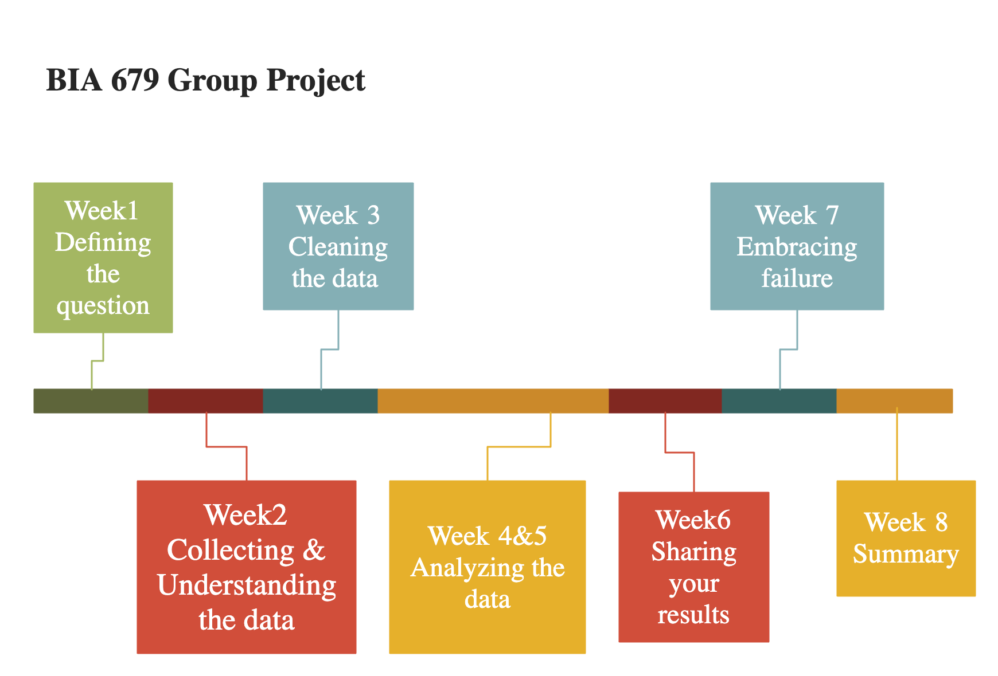

Slide 9
Reference
Zhao, Xuesong. “A Study on e-Commerce Recommender System Based on Big Data.” 2019 IEEE 4th International Conference on Cloud Computing and Big Data Analysis (ICCCBDA), 2019, https://doi.org/10.1109/icccbda.2019.8725694.
Jessica Young | Feb 18, 2022, et al. “US Ecommerce Grows 14.2% in 2021.” Digital Commerce 360, 16 Sept. 2022, https://www.digitalcommerce360.com/article/us-ecommerce-sales/.
“H&M Personalized Fashion Recommendations.” Kaggle, https://www.kaggle.com/competitions/h-and-m-personalized-fashion-recommendations/data.

Slide 10
Thank you

